Slide 1
Website Design using CSS

Slide 2
Cascading Style Sheet
CSS stands for Cascading Style Sheet. It gives an additional style to the HTML document. A cascading style sheet is a language that is designed to define the document formatting and look written in a markup language. Generally, CSS is applied with HTML documents to change various styles of user interfaces and web pages.

Slide 3
Uses of CSS
We can add unique styles to our old documents of HTML.
We can change the overall look and feel of our website by following some changes in the CSS code.
A cascading style sheet can be used with JavaScript and HTML in most of the websites to develop user interfaces for a lot of mobile applications and user interfaces for various web applications.

Slide 4
Features of CSS
Opportunity in Web designing: If anyone wants to begin a career in web designing professionally, it is essential to have knowledge of CSS and HTML.
Website Design: With the use of CSS, we can control various styles, such as the text color, the font style, the spacing among paragraphs, column size and layout, background color and images, design of the layout, display variations for distinct screens and device sizes, and many other effects as well.
Web Control: CSS has controlling power on the documents of HTML, so it is easy to learn. It is integrated with the HTML and the XHTML markup languages.
Other Languages: Once we have knowledge of some basics of CSS and HTML, other associated technologies like Angular, PHP, and JavaScript are become clearer to understand.

Slide 5
CSS Applications
Fast Page Loading: We don’t need to mention the attributes of the HTML element every time if we use CSS. We need to specify one rule of CSS for an element and use it for every occurrence of that element. So, short code means high-speed download times.
Easy Maintenance: To create a global alteration we need to alter the style. Every element will get automatically updated within all web pages.

Slide 6
Cont…
Superior HTML Styles: HTML contains few extended attribute’s array than CSS, thus we can provide a much better view to our HTML page as compared to HTML attributes.
Save Time: We can specify CSS once and reuse the same sheet within various HTML pages. We can describe a style for every HTML tag and apply this style to as a lot of web pages as we want.
Compatibility: The cascading style sheet permits content to be upgraded for one or more device types. Distinct versions of the website could be granted for various handheld devices like cell phones and PDAs, and for printing.
Global Standards: Now, the attributes of HTML are being recommended to apply CSS, and they are being deprecated. Thus it is better to begin the use of CSS in every HTML page for making them compatible for future browsers.

Slide 7
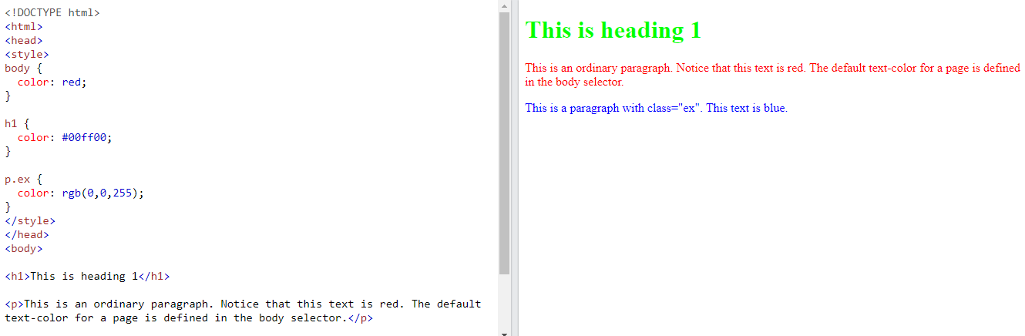
Changing of the text color

Slide 8
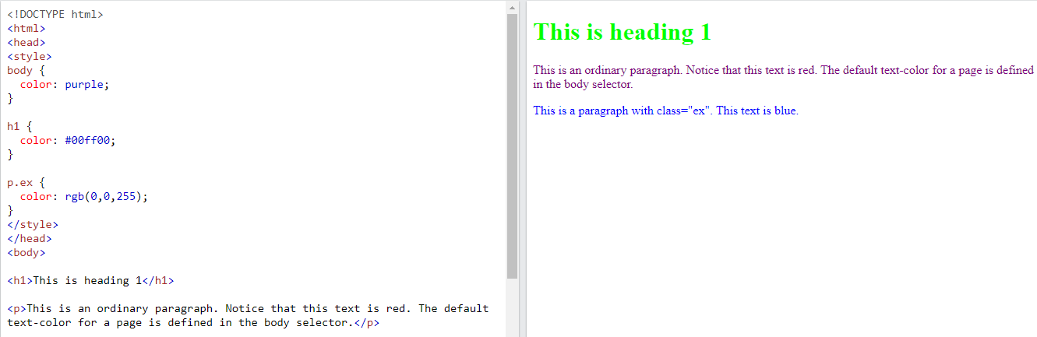
Cont…

Slide 9
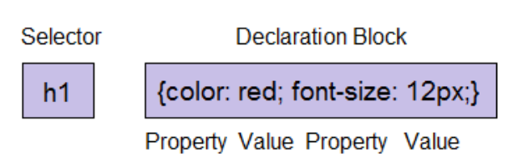
CSS Syntax
The CSS syntax contains the selector and the declaration block, which will be clearer with the following example:
Selector: A CSS selector specifies the HTML tag we wish to style. A selector can be any element such as <title>, and <h1>.

Slide 10
Syntax
Declaration Block: This block can consist of more than one declaration that is isolated by the semicolon. Here, there are two types of declarations for the example as mentioned above:
Color: red;
Font-size: 12px;
All the declarations include the property name and the value that are isolated by the colon.

Slide 11
Cont…
Property: It is a part of the HTML element’s attributes. A property could be any color or border.
Value: CSS properties are required to be assigned by some values. Thus, values are provided to the properties of CSS. Value “red” is given to the color property in the example, as mentioned above.

Slide 12
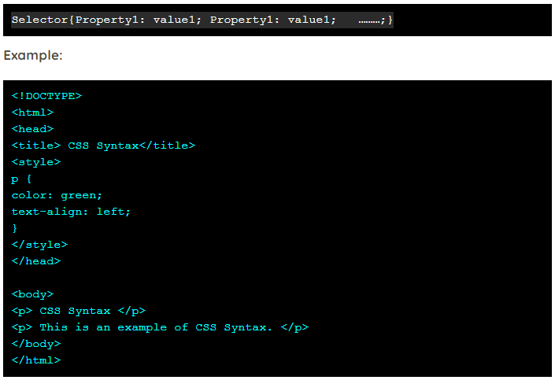
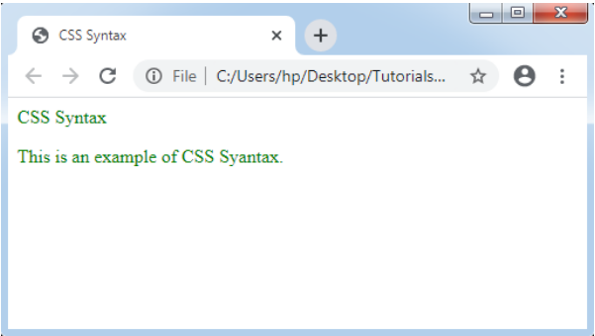
Explanation of Example:
P is the selector.
Color is the property.
The value of the property is green.
Another property is text-align.
The value of the property is left.

Slide 13
TEXT Features
Name of text feature | Purpose of text feature
Title | Quickly tells the reader what information they will learn about
Table of contents | Shows students the different chapter or section titles and where they are located
Index | Directs students where to go in the text to find specific information on a topic, word, or person
Glossary | Identifies important vocabulary words for students and gives their definitions
Headings or subtitles | Help the reader identify the main idea for that section of text
Sidebars | Are set apart from the main text, (usually located on the side or bottom of the page) and elaborate on a detail mentioned in the text
Pictures and captions | Show an important object or idea from the text
Labeled diagrams | Allow readers to see detailed depictions of an object from the text with labels that teach the important components
Charts and graphs | Represent and show data related to, or elaborate on, something in the main body of text
Maps | Help a reader locate a place in the world that is related to text
Cutaways and cross sections | Allow readers to see inside something by dissolving part of a wall or to see all the layers of an object by bisecting it for viewing
Inset photos | Can show either a faraway view of something or a close-up shot of minute detail

Slide 14
CSS Layout - The position Property
The position property specifies the type of positioning method used for an element (static, relative, fixed, absolute or sticky).

Slide 15
The position Property
The position property specifies the type of positioning method used for an element.
There are five different position values:
static
relative
fixed
absolute
sticky

Slide 16
position: static;
HTML elements are positioned static by default.
Static positioned elements are not affected by the top, bottom, left, and right properties.
An element with position: static; is not positioned in any special way; it is always positioned according to the normal flow of the page:

Slide 17
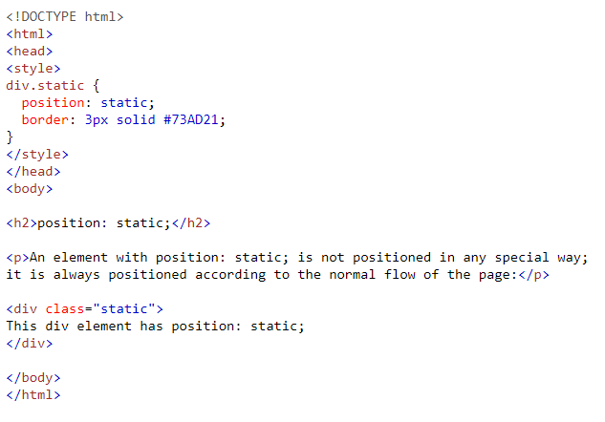
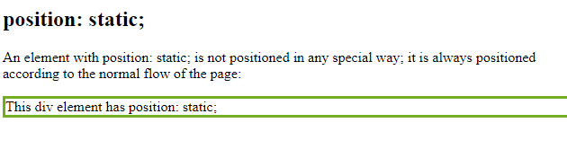
Cont…

Slide 18
position: relative;
An element with position: relative; is positioned relative to its normal position.
Setting the top, right, bottom, and left properties of a relatively-positioned element will cause it to be adjusted away from its normal position. Other content will not be adjusted to fit into any gap left by the element.

Slide 19
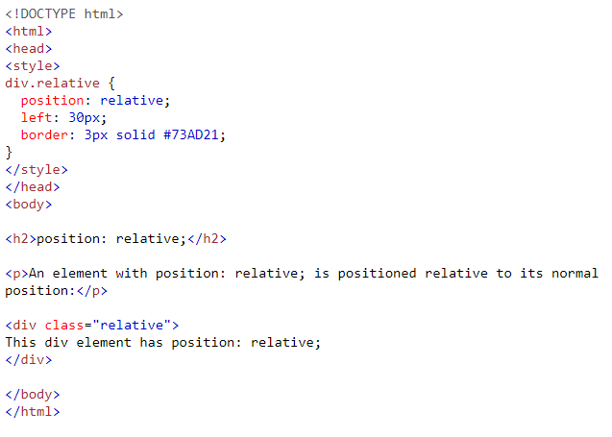
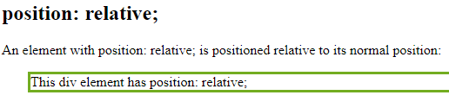
Cont…

Slide 20
position: fixed;
An element with position: fixed; is positioned relative to the viewport, which means it always stays in the same place even if the page is scrolled. The top, right, bottom, and left properties are used to position the element.
A fixed element does not leave a gap in the page where it would normally have been located.
Notice the fixed element in the lower-right corner of the page. Here is the CSS that is used:

Slide 21
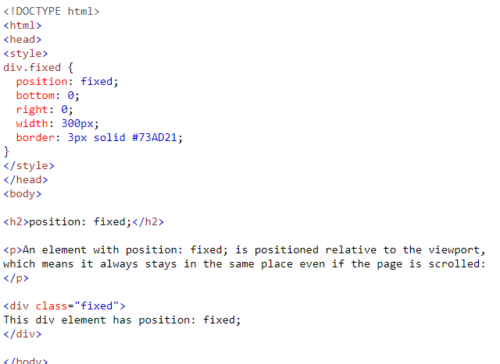
Cont…

Slide 22
position: absolute;
An element with position: absolute; is positioned relative to the nearest positioned ancestor (instead of positioned relative to the viewport, like fixed).
However; if an absolute positioned element has no positioned ancestors, it uses the document body, and moves along with page scrolling.
Note: Absolute positioned elements are removed from the normal flow, and can overlap elements.

Slide 23
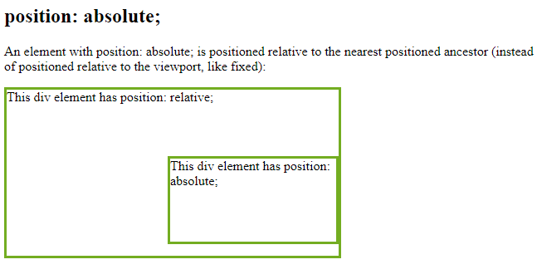
Cont…
<!DOCTYPE html>
<html>
<head>
<style>
div.relative {
position: relative;
width: 400px;
height: 200px;
border: 3px solid #73AD21;
}
div.absolute {
position: absolute;
top: 80px;
right: 0;
width: 200px;
height: 100px;
border: 3px solid #73AD21;
}

Slide 24
position: sticky;
An element with position: sticky; is positioned based on the user's scroll position.
A sticky element toggles between relative and fixed, depending on the scroll position. It is positioned relative until a given offset position is met in the viewport - then it "sticks" in place (like position:fixed).

Slide 25
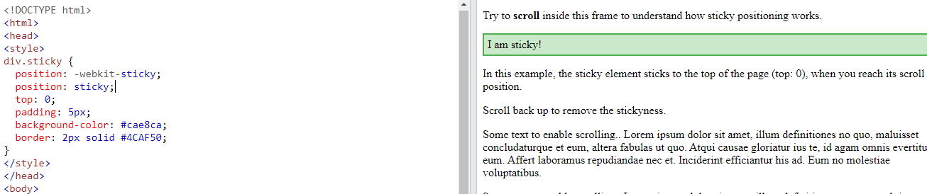

Slide 26
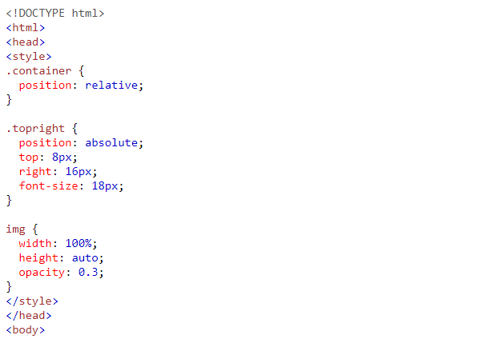
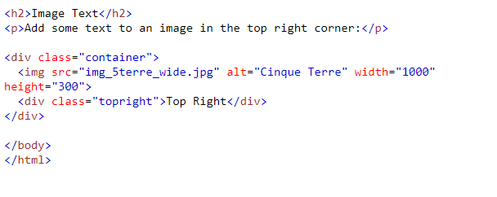
Text on image

Slide 27
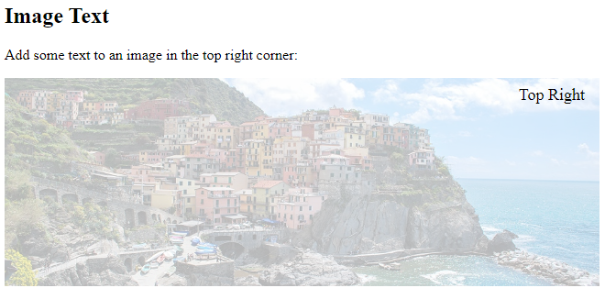
Output

Slide 28
Positioning Properties
Property | Description
bottom | Sets the bottom margin edge for a positioned box
clip | Clips an absolutely positioned element
left | Sets the left margin edge for a positioned box
position | Specifies the type of positioning for an element
right | Sets the right margin edge for a positioned box
top | Sets the top margin edge for a positioned box

Slide 29
What are CSS Animations?
An animation lets an element gradually change from one style to another.
You can change as many CSS properties you want, as many times as you want.
To use CSS animation, you must first specify some keyframes for the animation.
Keyframes hold what styles the element will have at certain times.

Slide 30
properties:
@keyframes
animation-name
animation-duration
animation-delay
animation-iteration-count
animation-direction
animation-timing-function
animation-fill-mode

Slide 31
The @keyframes Rule
When you specify CSS styles inside the @keyframes rule, the animation will gradually change from the current style to the new style at certain times.
To get an animation to work, you must bind the animation to an element.
The following example binds the "example" animation to the <div> element. The animation will last for 4 seconds, and it will gradually change the background-color of the <div> element from "red" to "yellow":

Slide 32
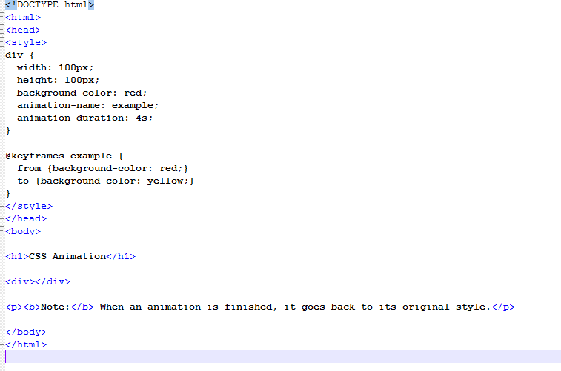
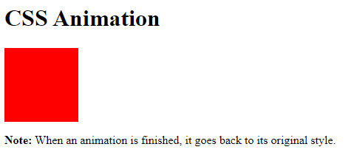
CSS Animation

Slide 33
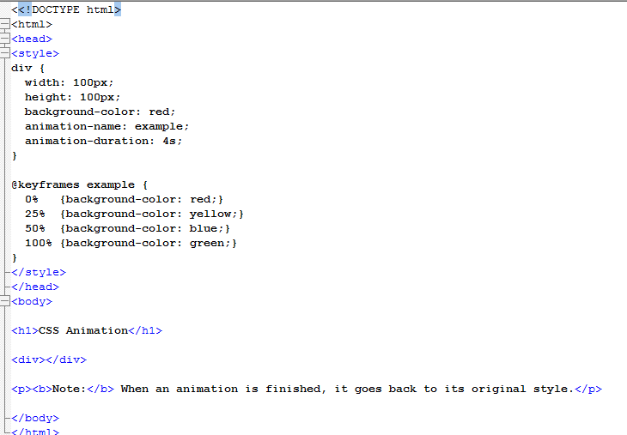
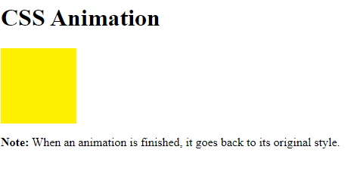
animation-duration

Slide 34
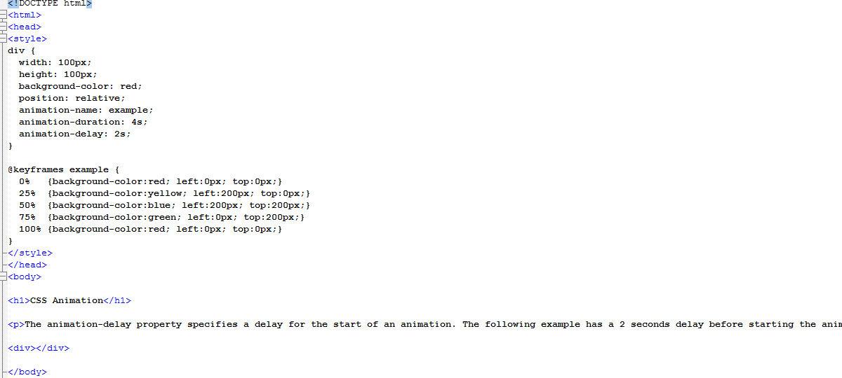
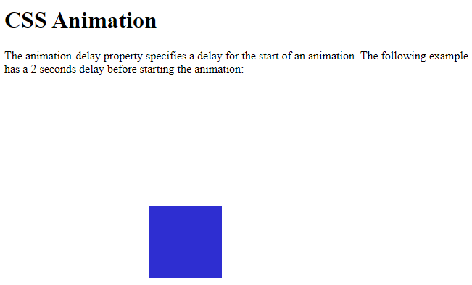
animation-delay

Slide 35
Run Animation in Reverse Direction or Alternate Cycles
The animation-direction property specifies whether an animation should be played forwards, backwards or in alternate cycles.
The animation-direction property can have the following values:
normal - The animation is played as normal (forwards). This is default
reverse - The animation is played in reverse direction (backwards)
alternate - The animation is played forwards first, then backwards
alternate-reverse - The animation is played backwards first, then forwards

Slide 36
Example
div { width: 100px; height: 100px; position: relative; background-color: red; animation-name: example; animation-duration: 4s; animation-direction: reverse; }

Slide 37
Specify the Speed Curve of the Animation
The animation-timing-function property specifies the speed curve of the animation.
The animation-timing-function property can have the following values:
ease - Specifies an animation with a slow start, then fast, then end slowly (this is default)
linear - Specifies an animation with the same speed from start to end
ease-in - Specifies an animation with a slow start
ease-out - Specifies an animation with a slow end
ease-in-out - Specifies an animation with a slow start and end
cubic-bezier(n,n,n,n) - Lets you define your own values in a cubic-bezier function

Slide 38
Example
#div1 {animation-timing-function: linear;} #div2 {animation-timing-function: ease;} #div3 {animation-timing-function: ease-in;} #div4 {animation-timing-function: ease-out;} #div5 {animation-timing-function: ease-in-out;}

Slide 39
Specify the fill-mode For an Animation
CSS animations do not affect an element before the first keyframe is played or after the last keyframe is played. The animation-fill-mode property can override this behavior.
The animation-fill-mode property specifies a style for the target element when the animation is not playing (before it starts, after it ends, or both).
The animation-fill-mode property can have the following values:
none - Default value. Animation will not apply any styles to the element before or after it is executing
forwards - The element will retain the style values that is set by the last keyframe (depends on animation-direction and animation-iteration-count)
backwards - The element will get the style values that is set by the first keyframe (depends on animation-direction), and retain this during the animation-delay period
both - The animation will follow the rules for both forwards and backwards, extending the animation properties in both directions

Slide 40
Animation Shorthand Property
div { animation-name: example; animation-duration: 5s; animation-timing-function: linear; animation-delay: 2s; animation-iteration-count: infinite; animation-direction: alternate; }

Slide 41
CSS Properties
Property | Description
@keyframes | Specifies the animation code
animation | A shorthand property for setting all the animation properties
animation-delay | Specifies a delay for the start of an animation
animation-direction | Specifies whether an animation should be played forwards, backwards or in alternate cycles
animation-duration | Specifies how long time an animation should take to complete one cycle
animation-fill-mode | Specifies a style for the element when the animation is not playing (before it starts, after it ends, or both)
animation-iteration-count | Specifies the number of times an animation should be played
animation-name | Specifies the name of the @keyframes animation
animation-play-state | Specifies whether the animation is running or paused
animation-timing-function | Specifies the speed curve of the animation

Slide 42

Creating Website

Slide 43
Questions
What is CSS?
What are the uses of CSS?
What are the features of CSS?
What are the application of CSS?
What is the syntax of CSS?
Explain selector in CSS?
What are different text features IN CSS?
Explain position property in CSS?
Explain CSS Animation properties?

Slide 44
References
1.
https://www.tutorialspoint.com/css/css_syntax.htm
2.
https://slideplayer.com/slide/14361379/
3.
https://developer.mozilla.org/en-US/docs/Web/CSS/CSS_Values_and_Units
4.
https://www.digitalocean.com/community/tutorials/how-to-lay-out-text-with-css
5.
https://www.w3schools.com/

